Slide 1
LAB 8
Graphics and animation
Julio César Almada Fuerte
A00226046
ITE

Slide 2
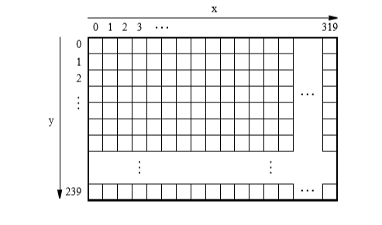
VGA
The DE10 includes a video out port with a VGA controller. It supports a screen resolution 640 x 480. The image displayed by the VGA controller is derived from 2 sources: a Pixel buffer and a character buffer.
Pixel Buffer: Holds the data for each pixel that is displayed. It provides an image resolution of 320 x 240 pixels, with coordinates 0,0 at the top left corner of the image. The VGA controller supports a screen resolution of 640 x 480 , each pixel value is replicatedin both X and Y dimensions.

Slide 3
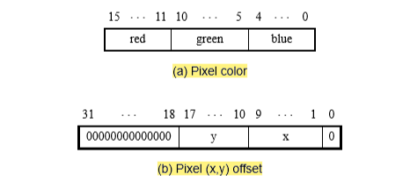
Pixel color represented by 16 bit halfword
Pixels are addressed in the pixel buffer by using the combination of a base address and an x,y offset.
The controller reads the pixel data in sequential order, starting with the pixel data corresponding to the upper-left corner of the VGA screen and proceeding to read the whole buffer until it reaches the data for the lower-right corner.

Slide 4
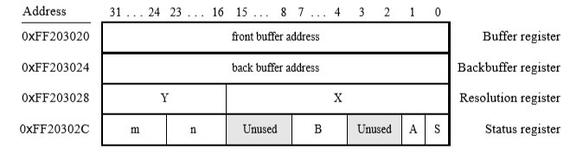
Double Buffering
2 pixel buffers are involved. There is one Backbuffer and Frontbuffer. Each one has a register address and you can use both by software. An image can be drawn into the Backbuffer but this one will not be displayed until a pixel buffer swap is performed. The swap is performed when a 1 is written into the buffer register.

Slide 5
Typical application of pixel buffer controller
While the image contained in the pixel buffer that is pointed to by the Buffer register is being displayed, a new image is drawn into the pixel buffer pointed to by the Backbuffer register. When this new image is ready to be displayed, a pixel buffer swap is performed. Then, the pixel buffer that is now pointed to by the Backbuffer register, which was already displayed,is cleared and the next new image is drawn. In this way,the next image to be displayed is always drawn into the “back” pixel buffer, and the “front” and “back” buffer pointers are swapped when the new image is ready to be displayed. Each time a swap is performed software has to synchronize with the VGA controller by waiting until the S bit in the Status register becomes 0.

Slide 6
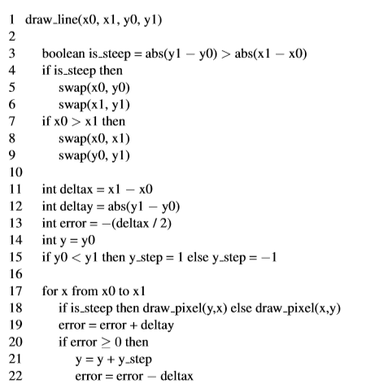
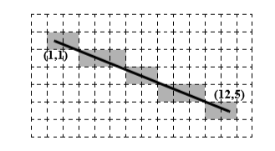
PART 1
Draw a line with the VGA.
Use this Pseudocode

Slide 7
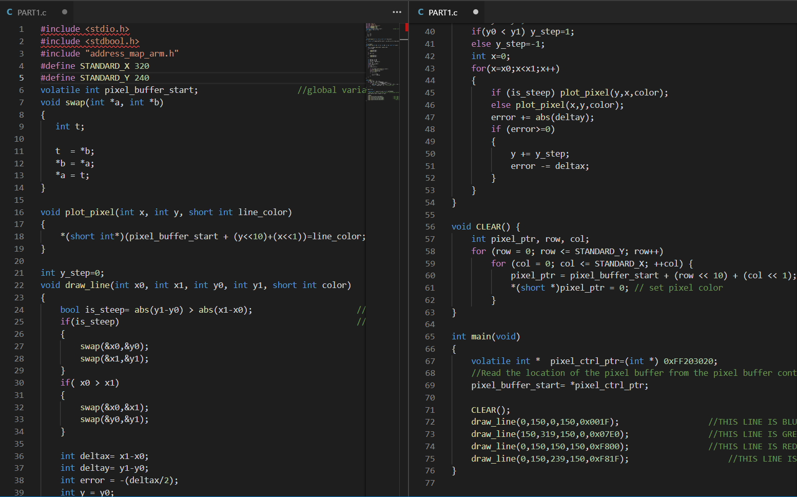

Slide 8
PART 2
Display a line moving Verticaly every 60th of a second.

Slide 9
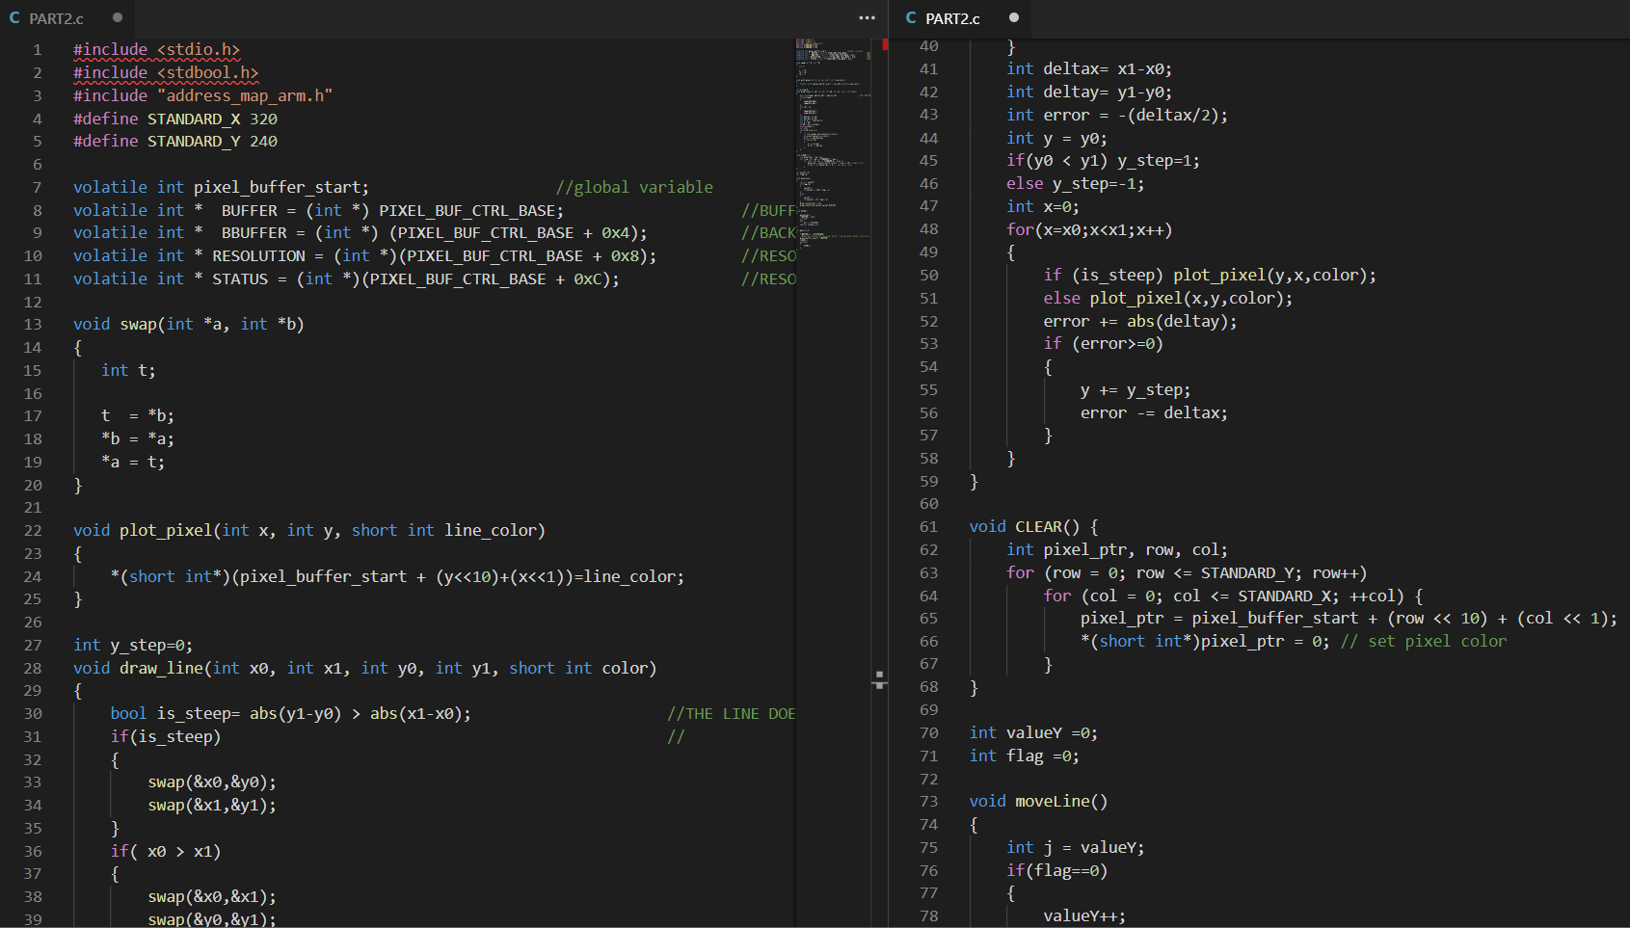

Slide 10
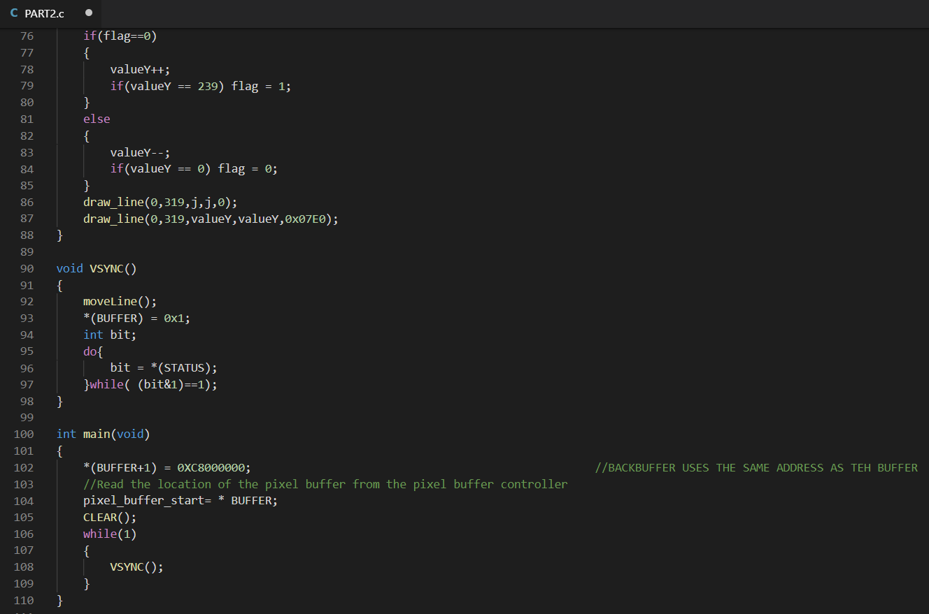

Slide 11
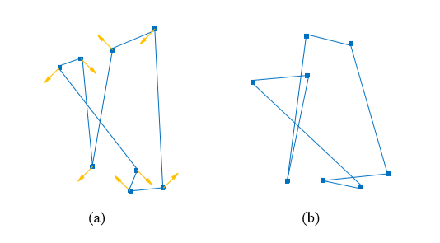
PART 3
Draw 8 points interconnected between them with lines, which are moving constantly.

Slide 12
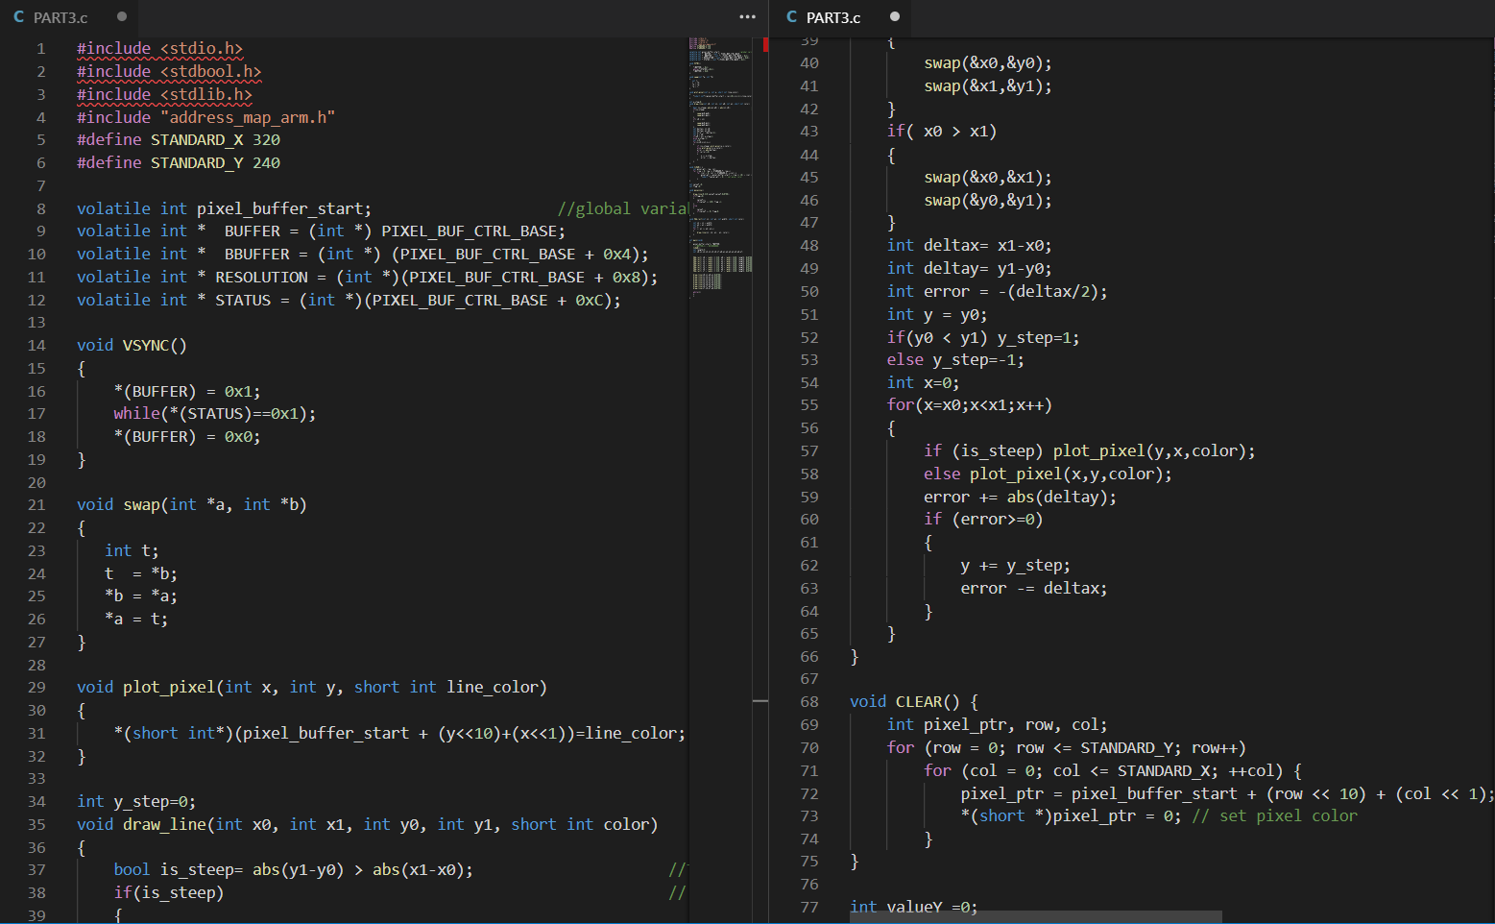

Slide 13
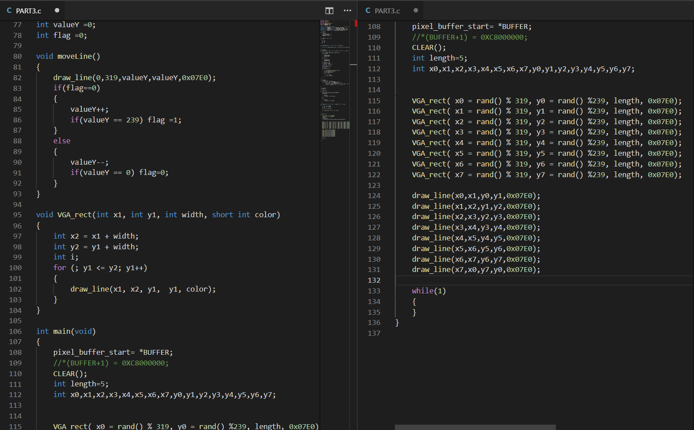

Slide 14
PART 4
The same as part 3 but you should be able to control the speed, the number of squares and toggle the lines between them if they are visible or not.

Slide 15
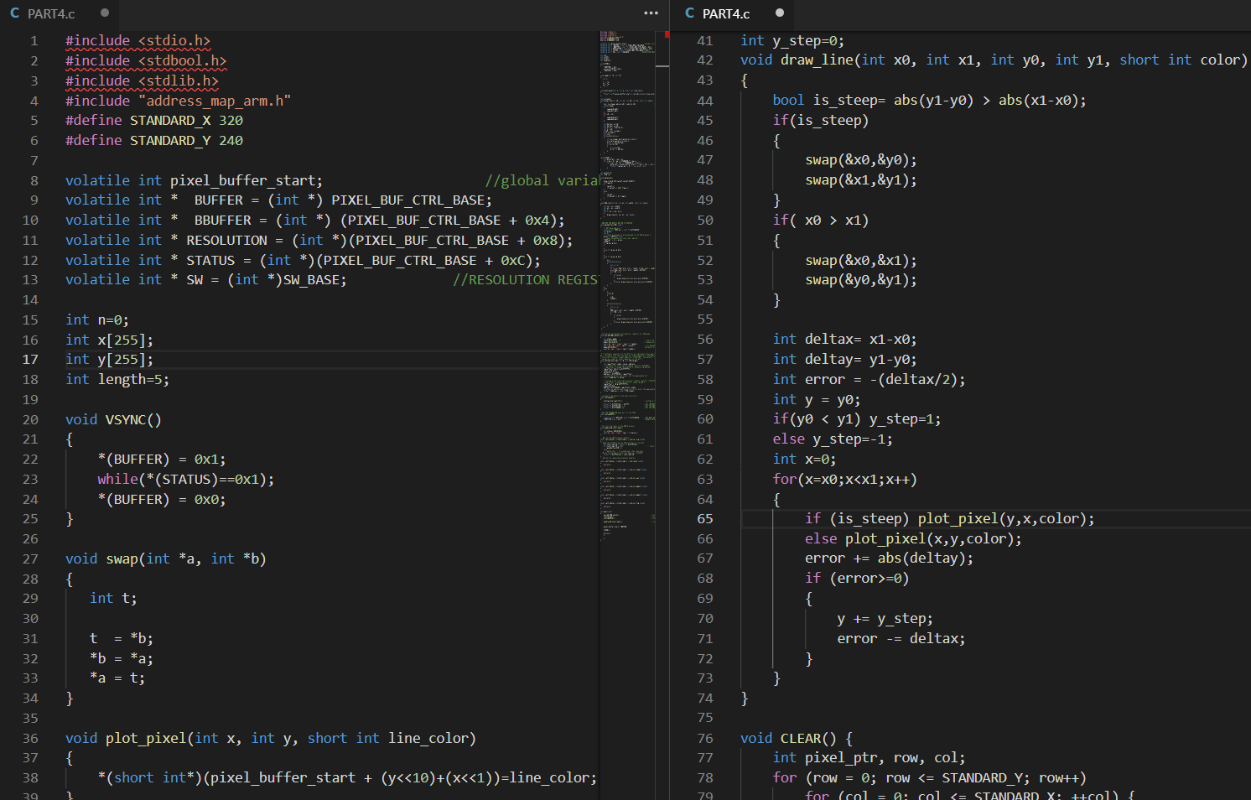

Slide 16
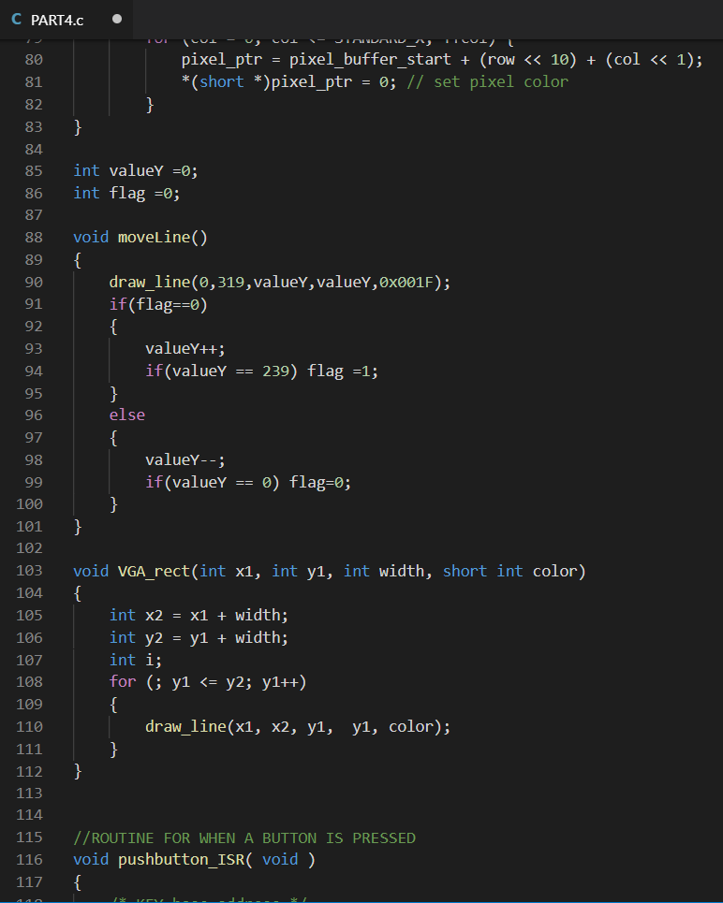

Slide 17
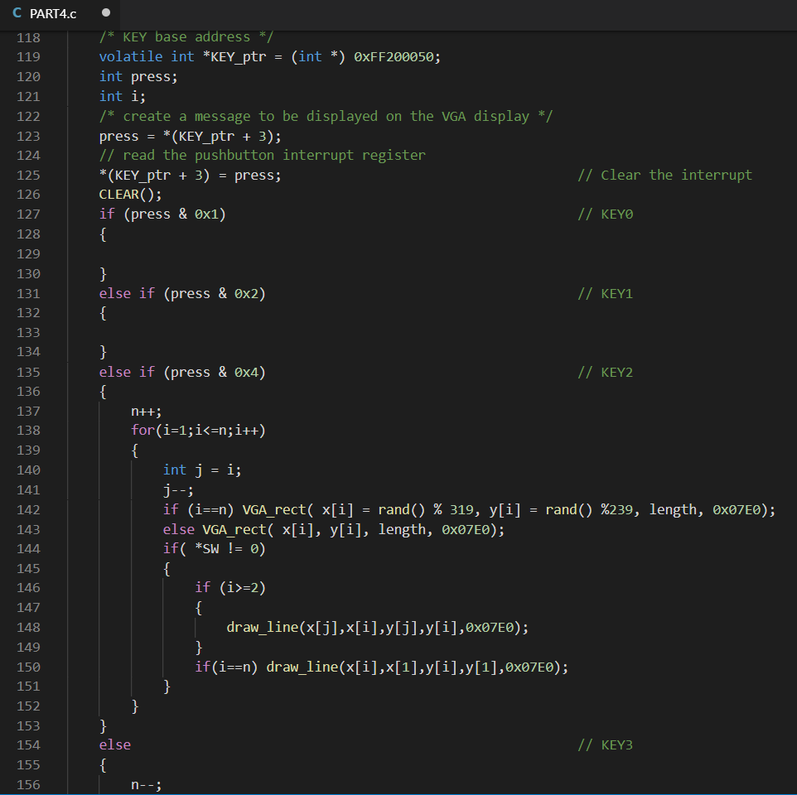

Slide 18
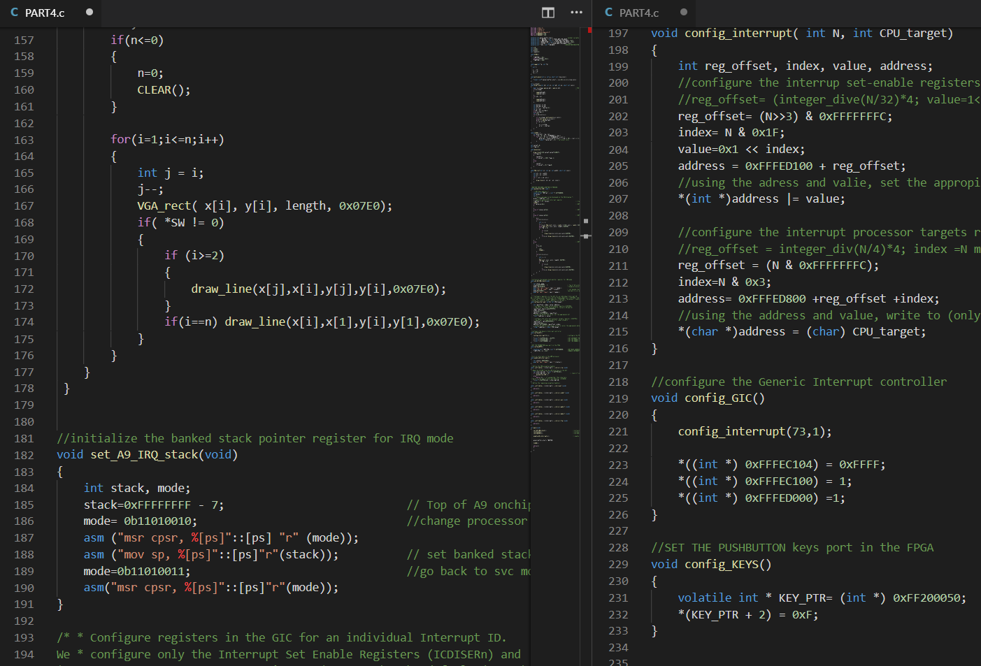

Slide 19
